Slide 1

Crohn disease (CD) is an inflammatory bowel disease (IBD) of unclear etiology. Unlike ulcerative colitis, CD is not limited to the colon but can manifest anywhere in the LOWER gastrointestinal tract.

Slide 2

CAUSES?!
Cause: Immune dysregulation and dysbiosis, which promotes chronic inflammation, the ultimate cause of which is not fully understood.
Risk factors
Familial aggregation
Genetic predisposition (e.g., mutation of the NOD2 gene, HLA-B27 association)
Tobacco smoke

Slide 3

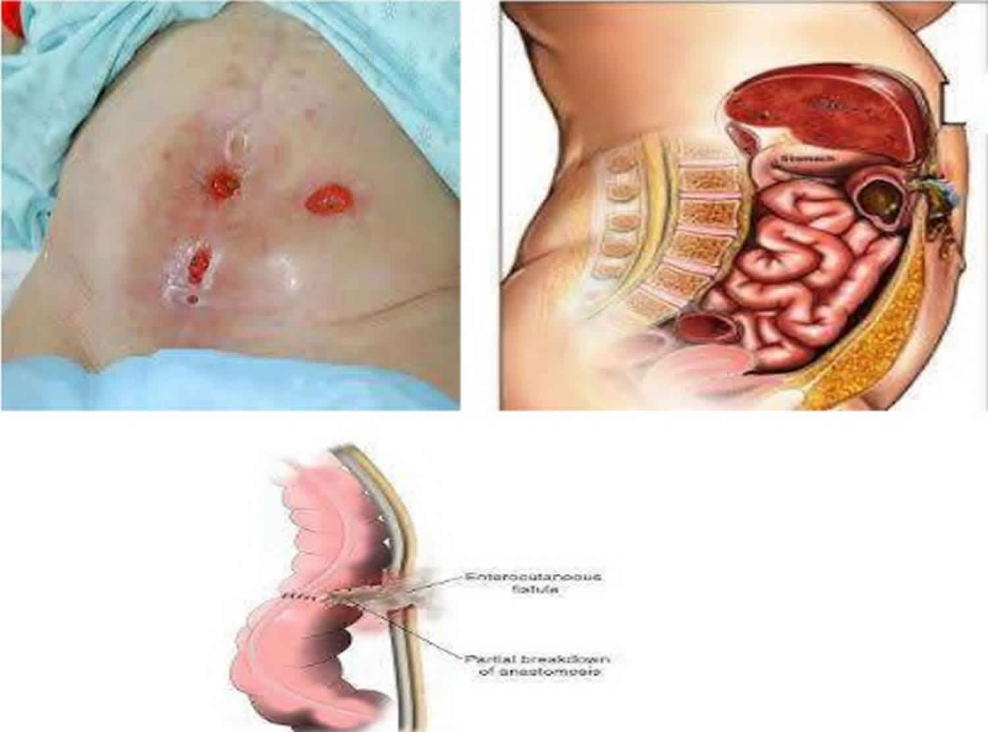
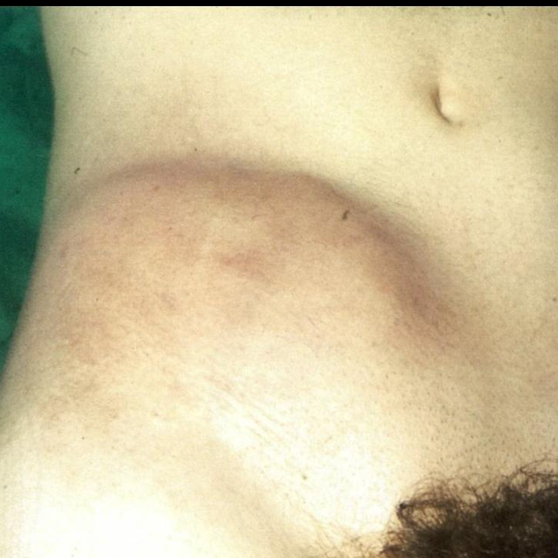
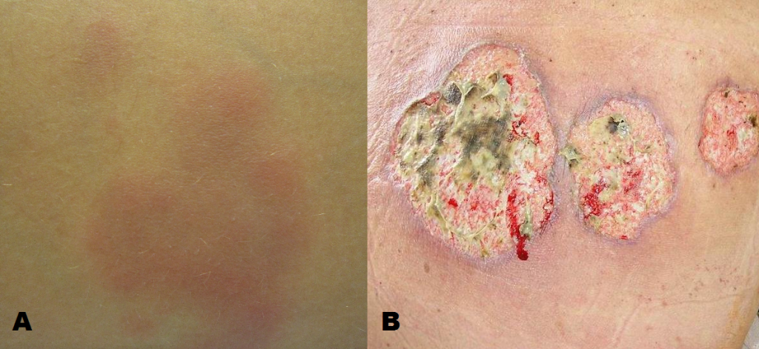
Specific Clinical Diagnosis Features
CD most commonly affects the terminal ileum.
Chronic diarrhea
Abdominal pain, typically in the RLQ
Palpable abdominal mass in the RLQ
Malabsorption (e.g., weight loss, anemia, failure to thrive)
Oral aphthous ulcers
erythema nodosum
Enterocutaneous or perianal fistulas, often associated with abscess formation, AS A FIRST SIGN OF CROHN DISEASE

Slide 4

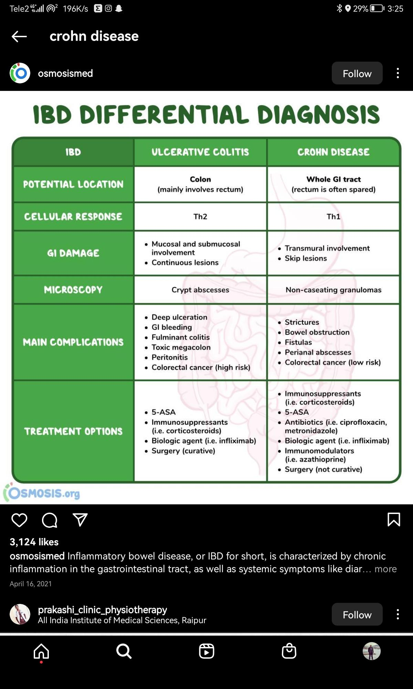

Slide 5

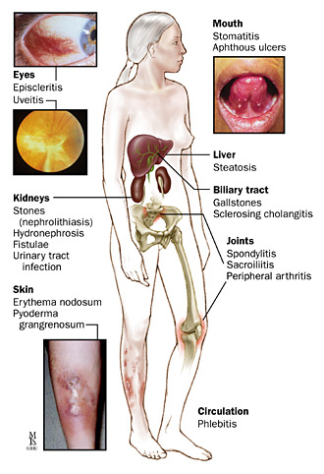
EXTRAINTISTINAL SYMPTOMES AND PHYSICAL EXAMINATION CHANGES
Joints
Enteropathic arthritis
A seronegative spondyloarthropathy
Affects the spine (e.g., sacroiliitis, spondylitis)
Nail clubbing
Eyes
Uveitis/Iritis
Episcleritis
Liver/bile ducts:
cholelithiasis
Urogenital system:
urolithiasis
Oral mucosa
Oral aphthae
Pyostomatitis vegetans
Skin
Erythema nodosum
Acrodermatitis enteropathica
Pyoderma gangrenosum
Painful, rapidly-progressive, red spots that can change into purulent pustules or deep ulcerated lesions with central necrosis

Slide 6

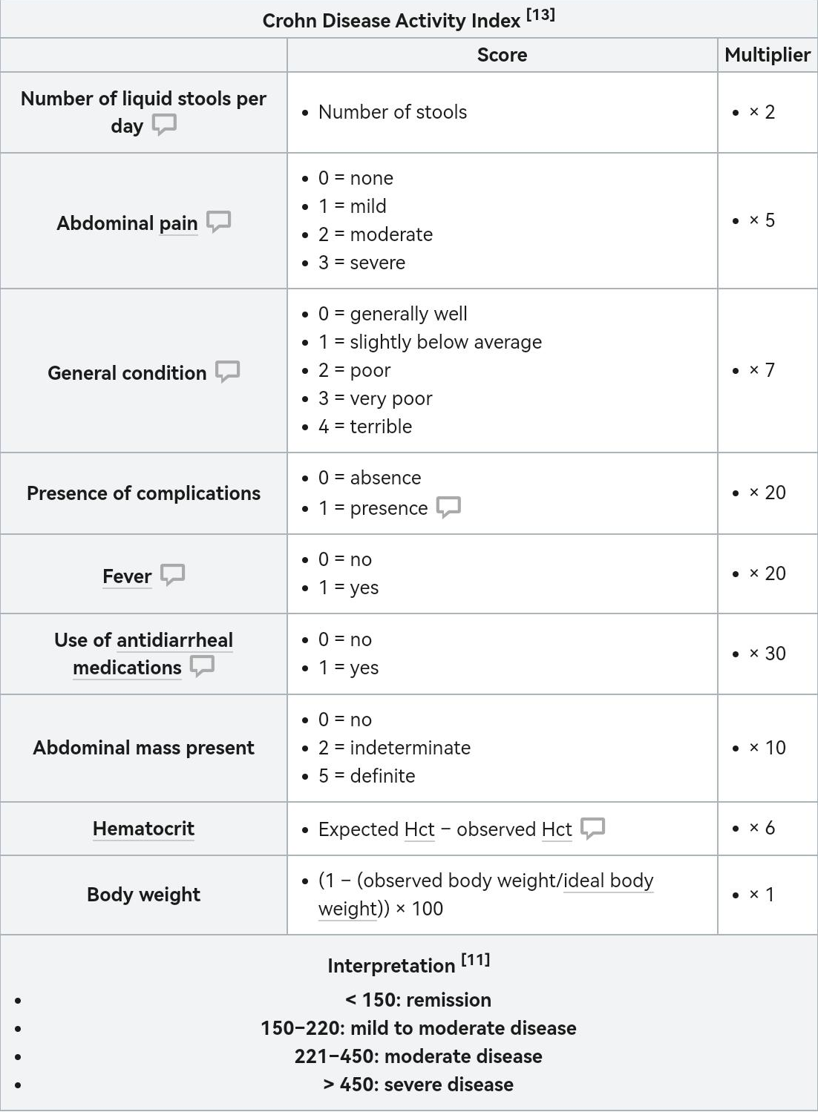
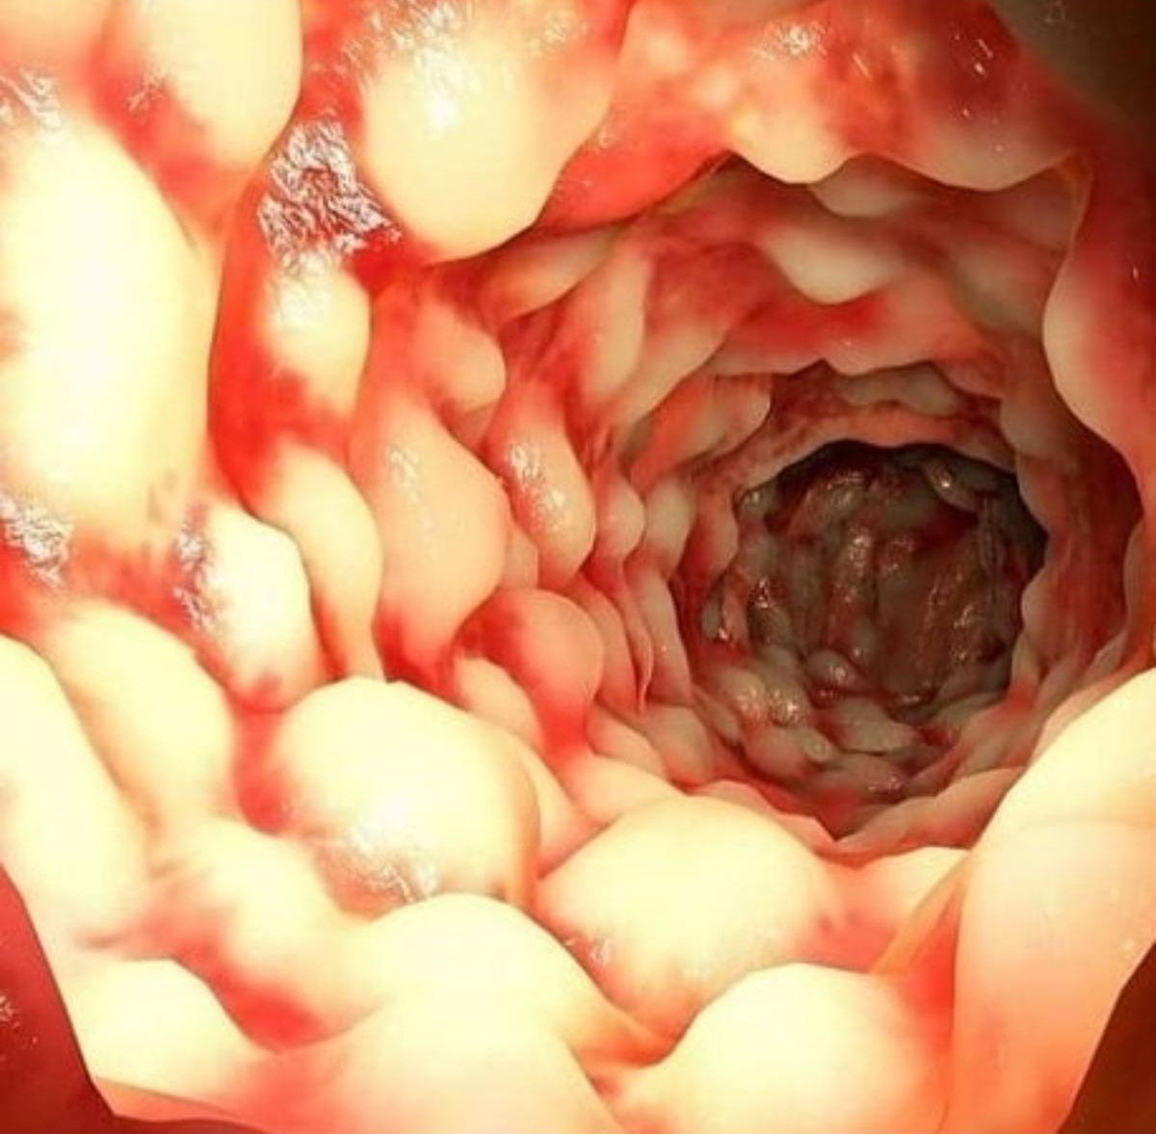
SEVERITY

Slide 7


DIAGNOSIS METHODES
1- Digital rectal examination: to assess for rectal bleeding With a lubricated, gloved finger, palpate the anal canal and rectum. Assess anal sphincter tone and the size and consistency of the prostate.
2- Labrototary diagnosis:
+CBC: anemia - thrombocytosis - leukocytosis
+BIOCHEMICAL TEST: ✓creatinin - iron low - B12 dificiency - HIGH CRP, ESR
+STOOL ANALYSIS: fecal calprotictin / lactoferrin present as inflammatory marker of intestine. AND a stool culture of C.difficle
3-Ileoolonoscopy
Findings:
✓Linear ulcerations
✓Erythema-fissures-strictures-fiatulas
Discontinuous areas of inflammation, cobblestone appearance of the affected mucosa, and mucosal ulcerations are hallmark endoscopic findings of CD

Slide 8

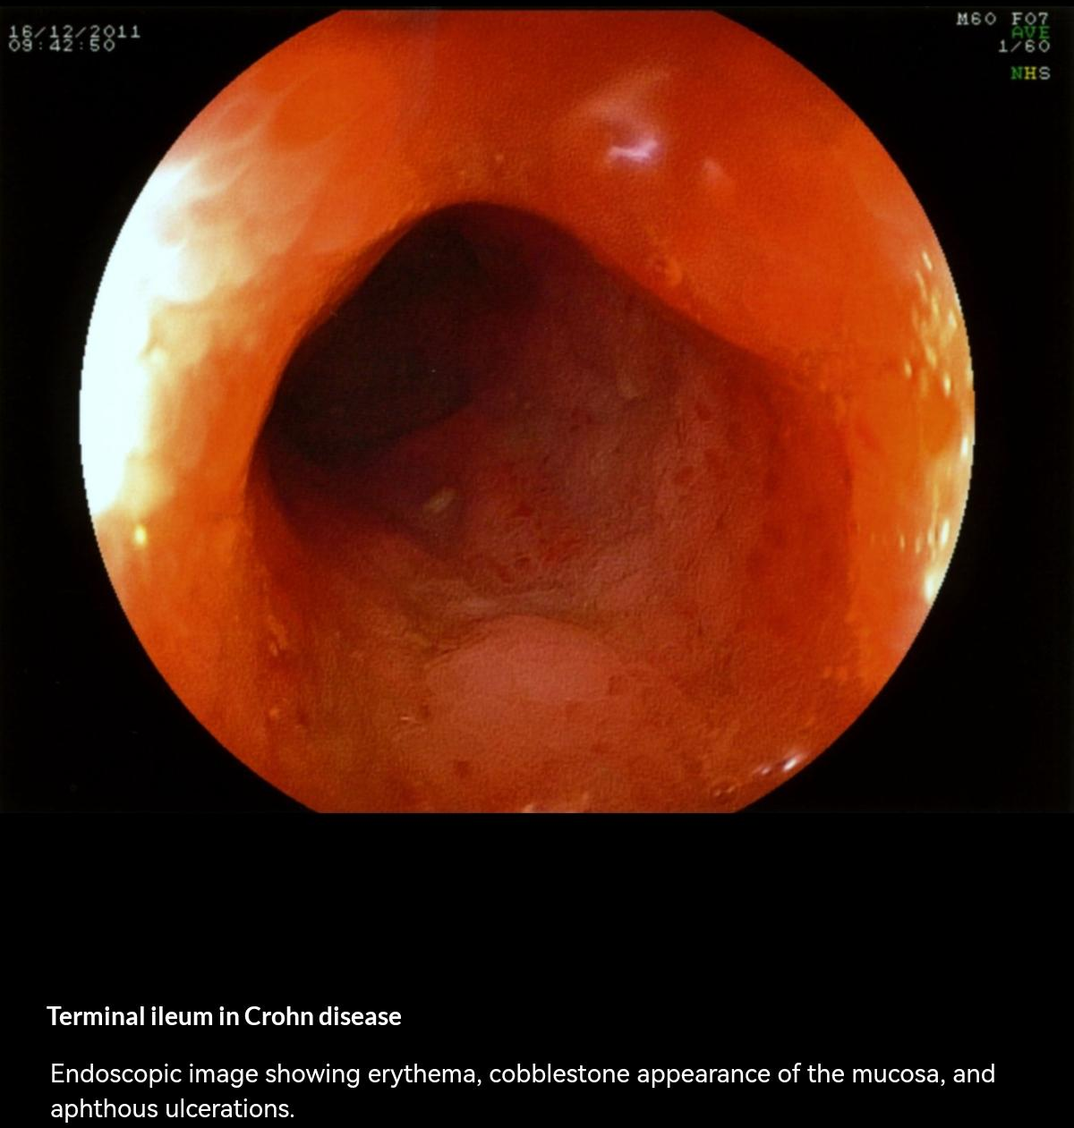
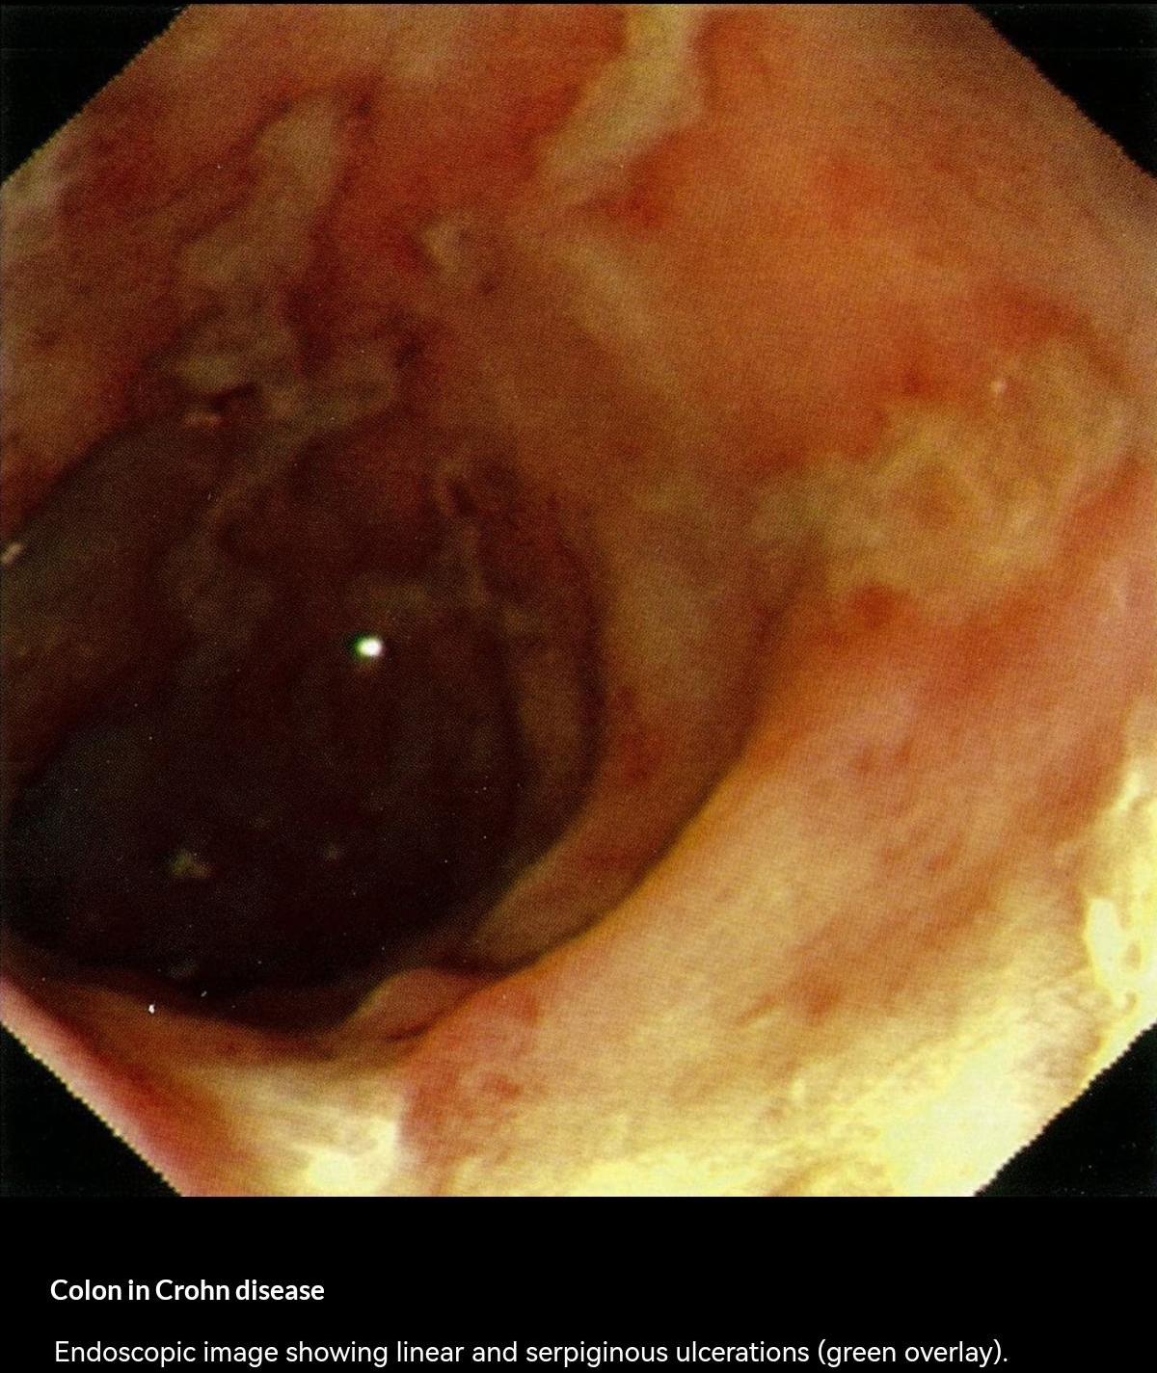

Slide 9
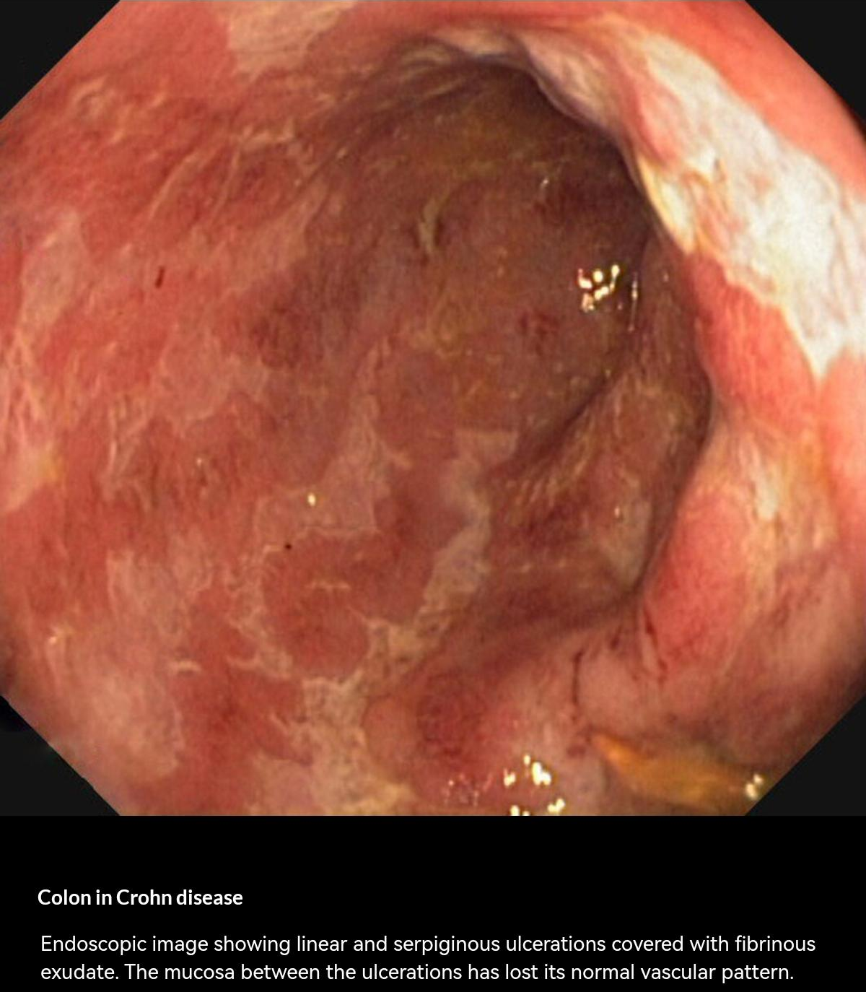

Slide 10

Treatment
Medical management aims to induce and maintain remission; it is tailored to the patient and influenced by the location and severity of CD.

Slide 11

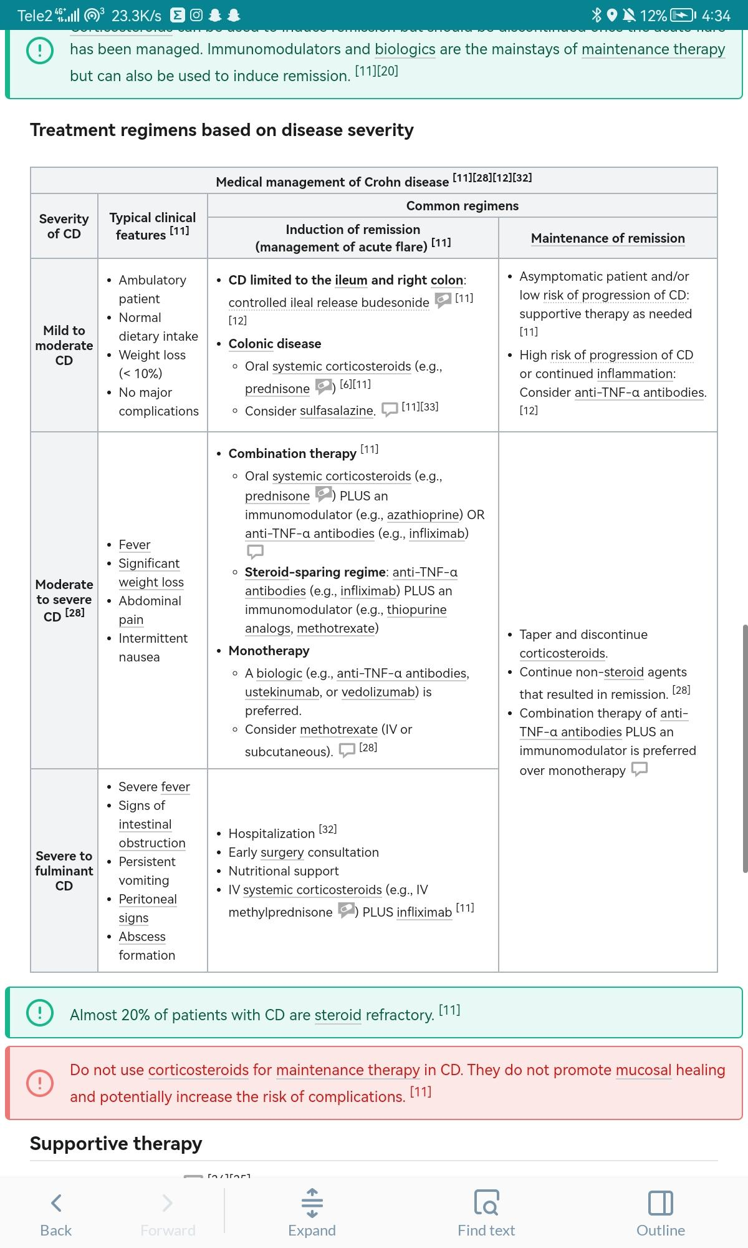

Slide 12


Slide 13


Slide 14

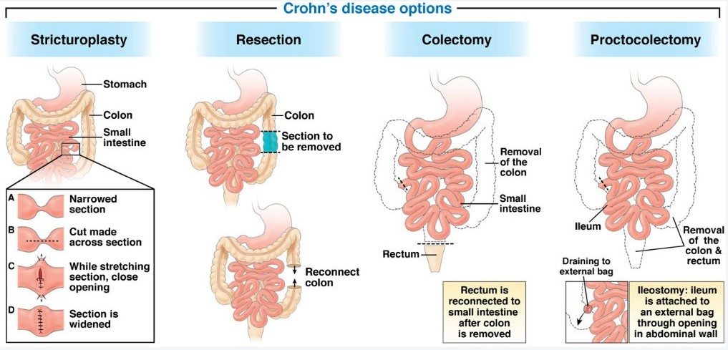

Slide 15

A 30-year-old female on regular OCPs
presents with complaints of intermittent colicky pain and diarrhoea for the past three months. After a thorough assessment, histopathology f the gut is advised. Histopathological examination of the bowel wall and regional lymph node shows characteristically non caseating granuloma with Langerhans giant cells. The consultant doctor suspects Crohn's disease. Which of the following is the best test for differentiating Crohn's disease from ulcerative colitis?
A ASCA
B P-ANCA
C Faecal alpha 1 antitrypsin
D Faecal calprotectin

Slide 16

A 41-year-old male patient presents with recurrent episodes of bloody diarrhoea for 5 years. Despite regular treatment with adequate doses of sulfasalazine, he has had several exacerbations of his disease and required several weeks of steroids to control flares. What should be the next step in management?
A Methotrexate
B Azathioprine
C Cyclosporine
D Cyclophosphamide

Slide 17

A 35-year-old female on OCPs presents with intermittent abdominal pain and intermittent diarrhoea. Endoscopy shows ileum involvement with rectal sparing. A colonoscopy reveals cobblestone mucosa. A perianal fistula is seen on local examination. Diagnosis of Crohn's disease is made. Which of the following is the best treatment for antibiotic refractory perianal fistula in Crohn's disease?
A Fistulectomy
B Infliximab
C Olasalizine
D Mesalamine

Slide 18

A patient with Crohn's disease presents
with an exacerbation of diarrhoea. He is
toxic with a slight fever, a right iliac fossa
mass and right sided loin pain. There are
no features of intestinal obstruction.
Which of the following is true:
A Ultrasound examination is helpful
B Treatment with steroids should be started
C Urgent laparotomy is required
D Metronidazole should be added to the treatment
E Azathioprine is rapidly effective

Slide 19



